Slide 1
Scalable and Precise Static Bug Finding for Industrial-Sized Code
PhD Thesis Defense
SHI, QINGKAI
Supervisor: Prof. Charles Zhang
Chair: Prof. Qinglu Zeng
Committee Members:
Prof. Xiangyu Zhang (Purdue University), Prof. Weichuan Yu (ECE)
Prof. Shing-Chi Cheung, Prof. Shuai Wang
Apr 23rd 2020
Notes:
Good morning. Thanks very much for attending my defense at this very difficult time in fighting with the new corona-virus.
In this defense, I will present my research on static bug finding for industrial sized code.

Slide 2
Outline
Background
Technical Contributions
The Pointer Trap
The Extensional Scalability Problem
The Limit of Parallelism
Conclusion
Notes:
My presentation consists of three parts:
The research background, the technical contributions that solve three important problems, and the conclusion

Slide 3
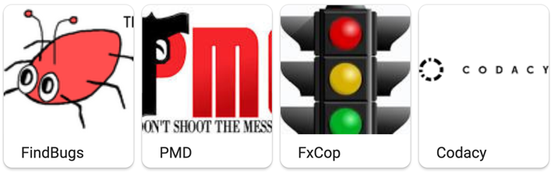
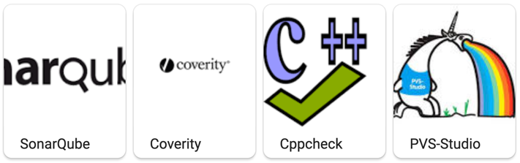

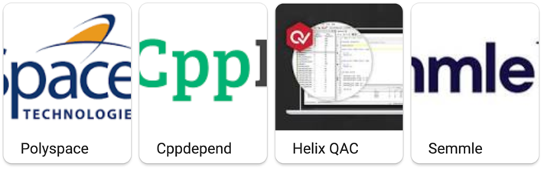
What is Static Bug Finding?
Finding Bugs in Software without Executing It
Notes:
In one word, static bug finding means that we do not need to run the code but just scan the source code to discover bugs or software vulnerabilities.
If we search in google, we will find many static bug finding tools developed using different techniques.

Slide 4

Why Static Bug Finding is Good?
High Coverage
Customization
Less Cost to Fix
Notes:
There are many good reasons to use these static bug finding tools in a project. One reason is that it performs a thorough analysis of your code. It scans ALL code. so If there are bugs in the distant corners of your software, even not used, then the static bug finding tools also have a higher probability of finding those bugs.
The Second benefit of using static bug finding is we can customize our project specific rules, and these rules will be ensured to follow without any manual intervention. If any team member forget to follow those rules, they will be highlighted by static bug finding tools so that we can avoid the violations. The Third major benefit is that they can find bugs early in the software development cycle, which means less cost to fix the bugs.

Slide 5

Who are Using Static Bug Finding?
Almost All Software Companies You Know
Notes:
Because of these benefits, almost all well-known software companies over the world, like Facebook and Google, use static bug finding to ensure the software quality.

Slide 6
How Static Bug Finding Helps?
”It has led to thousands of fixes of security and
privacy bugs!” ---- CACM 2019
”It prevents hundreds of bugs per day from entering the Google codebase.” ---- CACM 2018
Notes:
According to their reports, static bug finding has led to thousands of fixes of security and privacy bugs in facebook. it also prevents hundreds of bugs per day from entering the Google code base.

Slide 7
Common Vulnerabilities and
Exposures
Year
Notes:
Although many bug detectors have been deployed and we already have many achievements, we still suffer from many many software bugs in our everyday life. According to the statistics from the CVE database, the number of software bugs are growing very quickly. From 2017, we have more than 15 thousand serious bugs every year.

Slide 8
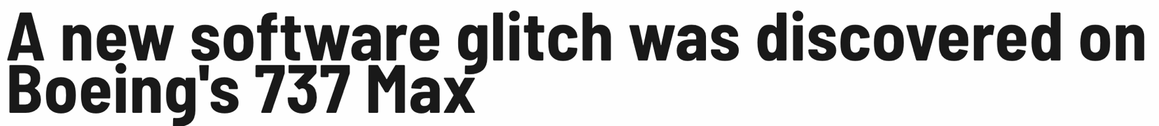



Notes:
These bugs may take away our lives, such as the software bugs in the Boeing 737Max aircraft
These bugs may take away a lot of money, such as the Gangnam style bug in Youtube and the Paypal bug that accidentally credits 92 quadrillion dollars
These bugs also may leak our privacy, just like the infamous heartbleed bug detected in 2014, which affects over half million websites and more than 10K cisco and juniper units.

Slide 9
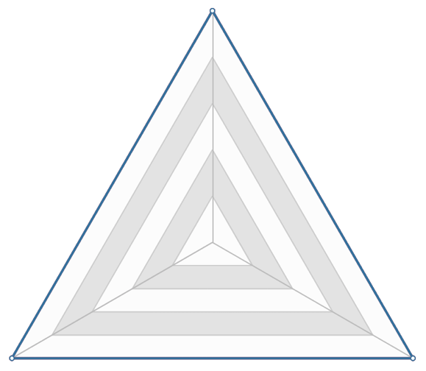
Heart Still Bleeding
Formal method that proves the absence of bugs
Bliz & Magic
Only for hundreds of LoC
Path-sensitive analysis that infers path feasibility
Saturn
23hr for 5MLoC
Clang
36hr for 1MLoC
Recall
sacrifice
Speed
Precision
[Chaki et al. 2004, Xie et al. 2005, Cho et al. 2013, Shi et al. 2020]
Notes:
Unfortunately, we observe that it is still difficult to automatically detect these bugs using static bug finding tools, because they often have to make a lot of tradeoffs among the speed, recall and precision.
Some techniques sacrifice the speed to achieve high recall and precision, just as shown by the radar chart where longer distance from an angle means more sacrifice in that dimension.
Such techniques include the formal methods that tries to prove the correctness of a program, path-sensitive analysis that infers the feasibility of program paths. These approaches are very expensive.
For example, Bliz and Magic only scale to hundreds of lines of code. Saturn, a path sensitive analyzer, may take 23hours to check 5 million lines of code. Clang, a symbolic-execution-based analyzer, may take 36 hours to check 1MLoC when full path-sensitivity is enabled.
4min

Slide 10
Heart Still Bleeding
Coarse-grained analysis
Function-level analysis
File-level analysis
Path-insensitive analysis
Saber
> 2/3 false positives
Infer
> 3/4 false positives
Recall
Speed
Precision
[Sui et al 2016, Shi et al. 2018, Fan et al 2019]
Notes:
To be fast, some approaches only perform coarse-grained analysis, such as function-level analysis, file level analysis, or path insensitive analysis
These approaches sacrifice recall and precision. For instance, Saber, a path-insensitive analyzer may produce more than 2/3 false positives, which is very imprecise. Infer, a bug detector powered by facebook, may prooduce >3/4 false positives for some kind of bugs.

Slide 11
Design Requirements to Stop Heart Bleeding
Big Size
1/2 MLoC, 92 directories, 3500 functions
Very Fast (5-10 Hours)
Scale to millions of lines of code
High Complexity
7 files, over 13,000 lines, 44 functions with intensive pointer operations
High Recall
Understand pointer operations and deep function calling contexts
Needle in a Haystack
memcpy: 647 places in over 100 files
Good Precision (< 30% False Positives)
Understand complex path conditions
[Bessey et al. 2010; Sadowski et al. 2018]
Notes:
So, what are the design requirements of a static bug finding tool so that we can automatically find bugs like heartbleed.
Heartbleed is in a typical industrial-sized project with half million LoC, 92 directories and over 3000 functions. In face of such large code base, a bug detector should be very fast and can check million lines of code in 5-10 hours.
The heartbleed bug spans across 7 files over 13,000 lines and 44 functions with intensive pointer operations. This implies that the bug detector should understand pointer operations and deep function calls, so that it will not miss any bugs in a conner.
The function that causes the heartbleed bug is used at more than 600 places in over 100 files. Detecting the bug is just like to find the needle in a haystack. So, we should keep good precision, so that we will not report too many false positives but exactly pinpoint the root cause of bug.

Slide 12
Design Requirements to Stop Heart Bleeding
Very Fast (5-10 Hours)
Scale to millions of lines of code
Recall
High Recall
Understand memory operations and deep calling contexts
Good Precision (< 30% False Positives)
Understand complex path conditions
Speed
Precision
[Bessey et al. 2010; Sadowski et al. 2018]
Notes:
In one word, we cannot make much compromise in all three aspects of speed, precision, and recall.

Slide 13
Stop Heart from Bleeding
Escaping from the Pointer Trap
Building precise program intermediate representation
Conquering the Extensional Scalability Problem
Efficiently checking multiple bug types at the same time
Breaking the Limit of Parallelism
Improving the parallelism to take advantage of multi-cores
Notes:
In this thesis, we solve three key problems for satisfying such rigorous design requirements. The pointer trap, solving this problem allows us to build a precise fundamental data structural known as program intermediate representation for checking bugs.
the extensional scalability problems, solving this problem allows us to check different bugs at the same time to save computational resources.
and the limit of parallelism, solving this problem allows us to benefit from multicores in modern computers.

Slide 14
Research Impact - I
Detecting Hundreds of Real Bugs in Open-Source Software
Firefox, MySQL, Python, Apache, Redis, OpenSSL, …
Being Assigned a Dozen of CVE IDs
CVE-2017-14952,
CVE-2017-14952,
CVE-2017-15096,
CVE-2018-20786,
…
Notes:
Armed with these techniques, our approach has detected hundreds of real bugs in open source software. Some of the detected bugs have been assigned CVE IDs due to the high security impact.

Slide 15





Research Impact - II
Improving the Software Security for Hundreds of Organizations
Apple, Microsoft, HP, Adobe, IBM, Audi, Yahoo, …
Being Used in Many Software Companies
Alibaba, Baidu, Wechat, CASC, …
Notes:
Detecting these bugs helped a lot of companies or orgnizations to improve their software security. specially, Our static bug finding tool, Pinpoint, has been commercialized and widely used in many software companies in China to ensure software quality.

Slide 16
Technical Contributions
The Target Software Bugs – Value-Flow Problems
Escaping from the Pointer Trap
Conquering the Extensional Scalability Problem
Breaking the Limit of Parallelism
Notes:
In detail, let me first introduce the target software bugs we aim to tame, which is known as the value flow problem.
7:10

Slide 17



Entering the Beast
BIO_read(…, buf, …);
s->s3->rrec.data[0] = buf
p = &s->s3->rrec.data[0]
payload = *p
tls1_process_heartbeat
@2541 memcpy(bp, pl, payload)
target memory
how many to copy
source memory
Notes:
The infamous heartbleed bug is a typical example of value flow problems. It happens at the memory copy statement, which consumes an invalid value of the variable payload.
The memcopy statement copies the memory from the source memory pl to the target memory bp. The size of the memory to copy is controlled by the variable payload. If the value of payload is smaller than the source memory size, it is safe. However, if the value of payload is larger than the source memory size, it will cause a overflow bug.
Unfortunately, the value of payload can be controlled by attackers. The system can read attackers' input via the BIO_read function, and store the attackers' input in the variable buf. Through some complex pointer operations, the value of buf flows to the variable payload and finally reaches the memcpy statement, causing the buffer overflow bug.
We say this is a value-flow problem because the bug is caused by improper value flows from the variable buf to the memcpy statement.

Slide 18
Value Flow Problems
Value Flow (Data Flow / Data Dependence)
Value Flow Problems
We say the value of a variable x flows to the other variable y if
y = x;
*p = x; q = p; y = *q;
A value improperly flows to some sensitive program statements
p = nullptr;
q = p; *q = 2; // null pointer dereference (CWE-476)
Notes:
Generally, we say the value of a variable x flows to the variable y if x is assigned to y directly through an assignment or indirectly via some pointer operations.
A value flow problem means that a value improperly flows to some sensitive program statements.
In addition to the heartbleed bug,
here is another example where a null pointer flows to a dereference statement through two variables, p and q, causing a null pointer dereference bug.

Slide 19


Value Flow Problems
Double Free
Taint Issues
Use After Free
Invalid Use of Memory
XSS
Leak of Sensitive Data
Stack Address Escape
CSRF
Use of Uninitialized Variable
SQL Injection
Null Pointer Dereference
Command Injection
Notes:
In practice, value-flow problems are very common，including invalid use of memory like double free/use after free; taint issues like SQL injection and command injection.
9min

Slide 20
“Dense” Program Analysis
control flow
Tracking value flows on the control flow graph
Many classic approaches:
IFDS/IDE
Saturn
Calysto
Clang
Infer
Performance problems:
6-11 hours for checking null dereferences for programs of 680KLoC
x=…
…
…
y=x
[Reps et al 1995; Babic et al 2008; Xie et al 2005]
Notes:
To detect these value flow problems, static bug detectors can be implemented either in a dense manner or a sparse manner.
dense analysis, including IFDS framework, Saturn, Calysto, tracks value flows based on the control flow graph, analyzing the program statement by statement
So, they will analyze a lot of unrelated statements,
As the example shown on the right, the blue statements are unrelated to the value flow from x to y.
But if we follow the dense approach, we have to take them into consideration, leading to many performance issues.
According to a recent report, a dense approach may take 6-11 hours for only checking one value flow problem in a small program

Slide 21
“Sparse” Program Analysis
control flow
Track value flows sparsely via data dependence
cheaper
skip irrelevant statements
Many classic approaches:
Fastcheck
Saber
SVF
x=…
…
data dep.
…
y=x
data dep./value flow:
a variable refers to the value of the other variable
[Cherem et al 2007; Livshits et al 2003; Oh et al 2012; Sui et al 2016, …]
Notes:
On the other side, Recent work has shown that sparse analysis can be much cheaper because they track value flows sparsely via data/dep to skip unrelated statements.
In the example, along with the data dependence, the value of x can directly flows to y, skipping the unrelated blue statements and, thus, saving computational resources.

Slide 22
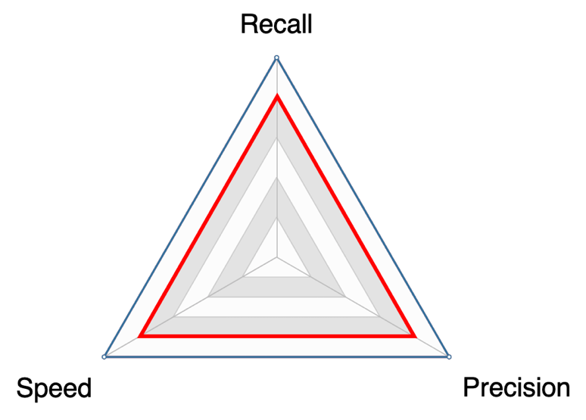
“Sparse” Program Analysis
Track value flows sparsely via data dependence
cheaper
skip irrelevant statements
Many classic approaches:
Fastcheck
Saber
SVF
[Cherem et al 2007; Livshits et al 2003; Oh et al 2012; Sui et al 2016, …]
Notes:
Such sparse analyses give us the hope of achieving high speed, high recall and high precision at the same time.

Slide 23
“Sparse” Program Analysis
control flow
Track value flows sparsely via data dependence
cheaper
skip irrelevant statements
Many classic approaches:
Fastcheck
Saber
SVF
*p=x
…
p alias q?
…
y=*q
data dep./value flow:
a variable refers to the value of the other variable
[Cherem et al 2007; Livshits et al 2003; Oh et al 2012; Sui et al 2016, …]
Notes:
However, because modern software is filled with pointer operations, building data dependence has to rely on a pre-computed pointer analysis, which also brings us many challenges.
As the similar example shown on the right, to determine the value flow between x and y, we need to query a pointer analysis whether the pointers P and Q may point to the same memory location.

Slide 24
“Sparse” Program Analysis
Challenge 1: Building precise DDG
Solution 1: Pinpoint (PLDI 2018)
Challenge 2: Checking multiple bug types
Solution 2 Catapult (ICSE 2020a)
Challenge 3: Checking bugs in parallel
Solution 3: Cheetah (ICSE 2020b)
p = nullptr;
q = p;
*q = 2;
p
nullptr
q
*q = 2
Notes:
So, to perform a sparse program analysis to detect value flow problems, our approach is performed in the following steps. First, we need to perform a pointer analysis to resolve pointer relations in an input program
Using the points-to relations we build ddg, just like the figure shown below where each vertex stands for a var or a stmt, and each edge stands for the value flow or data dep relations
The final step is to search invalid value flows on the ddg, with the help of an SMT solver to solve path conditions and prune infeasible paths
The first problem we addressed in the thesis is in the first phase of this work flow, that is, how to build precise DDG with a precise PTA
The second and third problems are in the second phase, which is how to efficiently check multiple bugs at the same time and the 3rd problem is how to improve the parallelism over existing parallel designs.

Slide 25
Technical Contributions
The Target Software Bugs – Value-Flow Problems
Escaping from the Pointer Trap
Conquering the Extensional Scalability Problem
Breaking the Limit of Parallelism
Notes:
Let me introduce the first work.
12m

Slide 26
The “Pointer Trap”
Precise
Precise
Precise
Bad Performance
Good Performance
Imprecise
Imprecise
Imprecise
Notes:
We refer to the first problem as the pointer trap, which means that we cannot achieve high precision and high scalability at the same time due to the high cost of pointer analysis.
That is, if we want to perform a precise sparse value-flow analysis to detect bugs, we need to build precise DDG. So, we need precise PTA to resolve precise points-to relations. However, it is well known that a precise PTA is very expensive.
To achieve good performance, we have to use an imprecise PTA, which will build a imprecise DDG. So, the final sparse value-flow analysis is imprecise.
Unfortunately, to the best of our knowledge, there is no existing sparse analysis that can escape from the pointer trap.

Slide 27
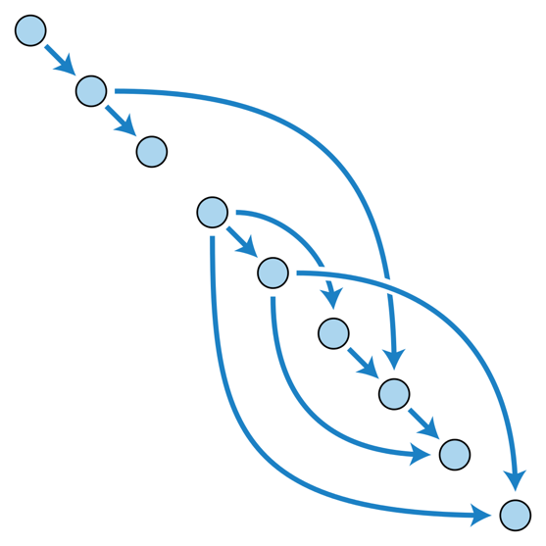
Trading Precision for Scalability
Use imprecise pointer analysis
Flow insensitive
not consider execution order of statements
Context insensitive
not distinguish different call sites
Compromise path-sensitivity
Only solve “easy” path conditions
False Edges
[Cherem et al 2007; Livshits et al 2003; Oh et al 2012; Sui et al 2016, …]
Notes:
To achieve scalability, existing approaches often only adopt flow insensitive analysis that does not consider the execution order of statements.
or context-insensitive analysis that does not distinguish different call sites.
They also often compromise path-sensitivity by only solving easy path conditions
As a result, there will be many false edges on the DDG, which will lead to many false positives when detecting bugs.
13m20

Slide 28
The 1st Contribution: Escaping from the Pointer Trap
Do Not Use an Independent Pointer Analysis
to Build Data Dependence
Avoid Computing Unnecessary Pointer Relations
Notes:
In this work, our main contribution is to resolve the pointer trap.
Our basic idea is that we should not use an independent PTA so that we can avoid computing unnecessary pointer relations and data dependence.

Slide 29
Limitation of an Independent Pointer Analysis
A lot of data dependence is irrelevant to the bugs to check
Pointer Analysis
Data Dependence Analysis
Value-Flow Analysis
unaware of what bugs to check
Notes:
Our key observation is that following the conventional design, we actually compute a lot of pointer relations and data dep that are not related to any bugs we are going to check.
This is because the direct client of the PTA is the DDA and the PTA is not aware of what bugs to check in the 3rd step.
So, we cannot avoid computing a lot of unnecessary pointer relations and data dependence, wasting a lot of computational resources

Slide 30
The Key Idea
Local pointer analysis is cheap
A
Function
foo
Function
bar
Function
qux
B
Notes:
In order to avoid the computation redundancy, instead of performing the pointer analysis independently, we first only perform function level PTA and build function-level DDG. Since the size of a function is often small, it is cheap to perform such local analysis.
These local DDG can be stitched together by connecting their interfaces, i.e., function parameters and return values.
When tracking inter-procedural values flows such as that from A to B, we can collect the interprocedural pointer information as well as the context and path information on demand. The collected information is input to a SMT solver to determine whether the value flow is feasible and may cause a bug.

Slide 31
The Key Idea
Slice away unnecessary inter-procedural analysis
A
Function
foo
C
D
Function
bar
Function
qux
B
Notes:
The key benefit of our approach is that at the time of tracking value flows for detecting a bug, it automatically slices away unnecessary inter-procedural analysis.
For instance, we do not need to analyze the inter-procedural relation between C and D, because it is not related to the value flow we are tracking.

Slide 32
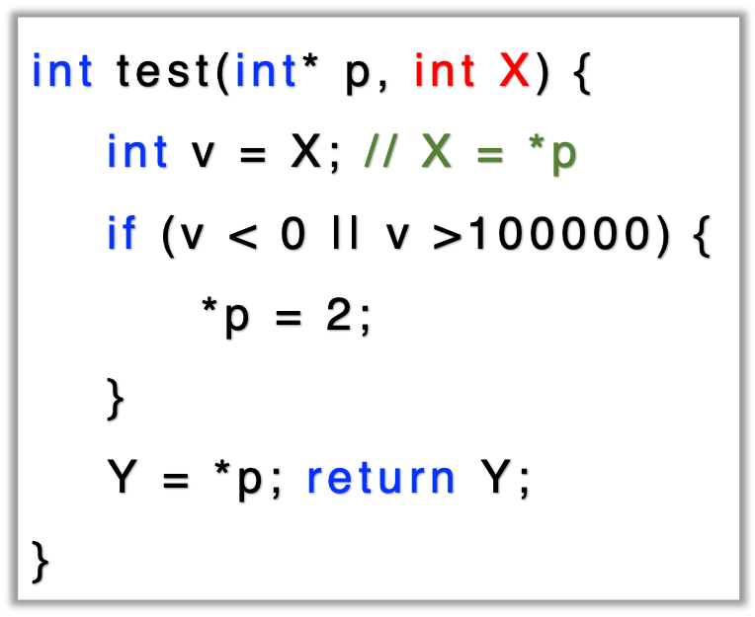
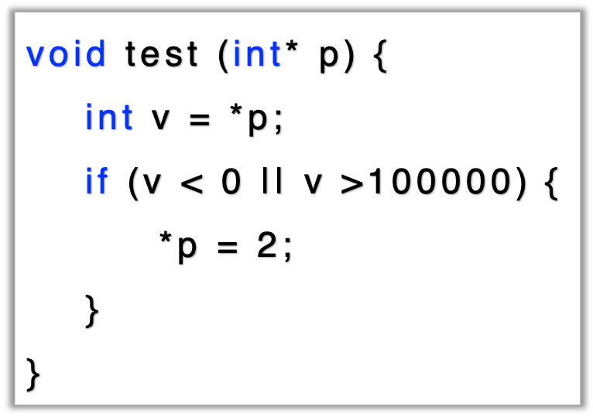
Building Function-Level Graphs
A side effect means that a function reads or modifies non-local memory, e.g., the memory pointed-to by p.
Notes:
Let us use a concrete example to demo our approach. We first perform a local pointer analysis to resolve the pointer relations as well as side effects of the function.
A side effect means that a function reads or modifies nonlocal memory, like the memory pointed-to by the function parameter p.
This function has two side effects.One is that the function reads a non-local memory pointed to by p. To eliminate the side effect, we add an extra param. X to represent the value stored in the non local memory.
The other side effect is that the function modifies the non-local memory by storing a new constant.
To eliminate the modification side effect, we add an extra return value to represent the value of the non local memory after running the function.

Slide 33
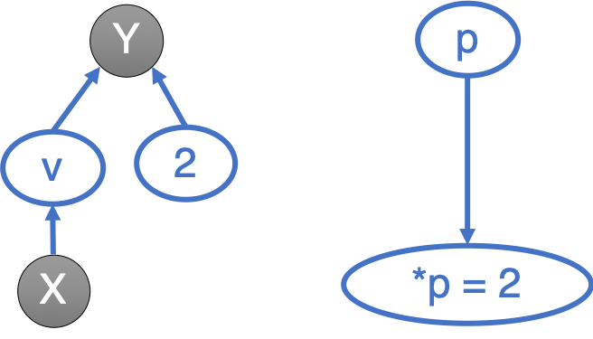
Building Function-Level Graphs
A side effect means that a function reads or modifies non-local memory, e.g., the memory pointed-to by p.
Notes:
After eliminating the side effects, we build the function level DDG/VFG,
which represents the value flow in the function.
For example, the value of Y may come from two places, it may be the constant 2 if we enter the if branch, or the original value v, if we do not enter the if branch.

Slide 34
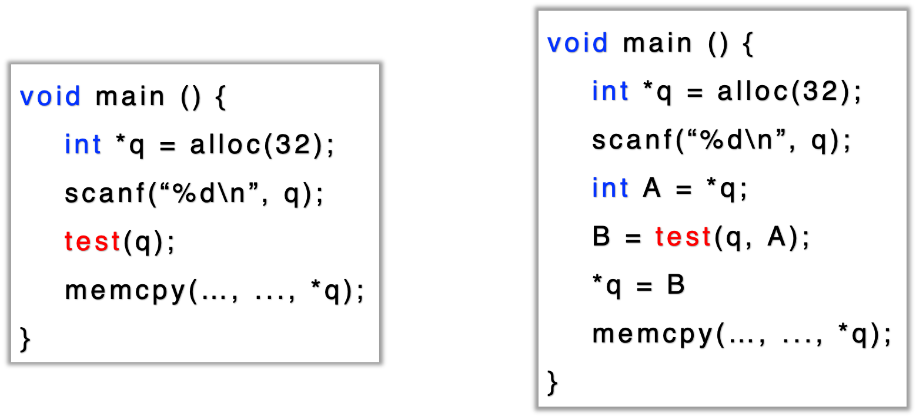
Building Function-Level Graphs
Notes:
To reflect the change of the function signature, we also insert two auxiliary variables in the caller function.

Slide 35
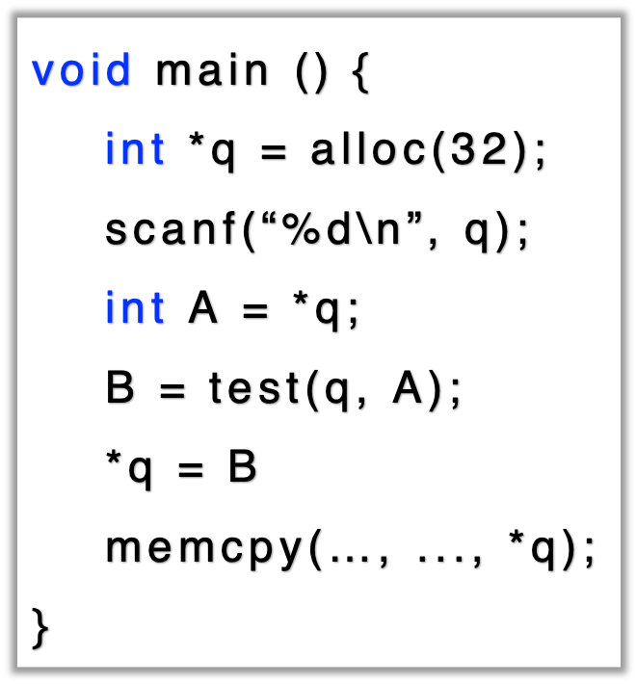
Building Function-Level Graphs
memcpy(…, *q)
q
A
B
Notes:
Similarly, after the transform,
we build the function level DDG,
where we have an edge from B to the memcpy function because B is the value stored in the memory pointed-to by q.

Slide 36
Value Flow Problem to Check
Get a user-input integer, stored in *q
source
A is the user-input integer
sink
The user input may cause buffer overflow
Notes:
Let us illustrate the VFA by checking whether the program contains a bug caused by the user input.
The main function accepts a user input via the scanf function. The var A is the user input value, which may cause an overflow bug at the memcpy function.
so, we need to track the value flows from the user input A to check whether it can reach the memcpy function.

Slide 37
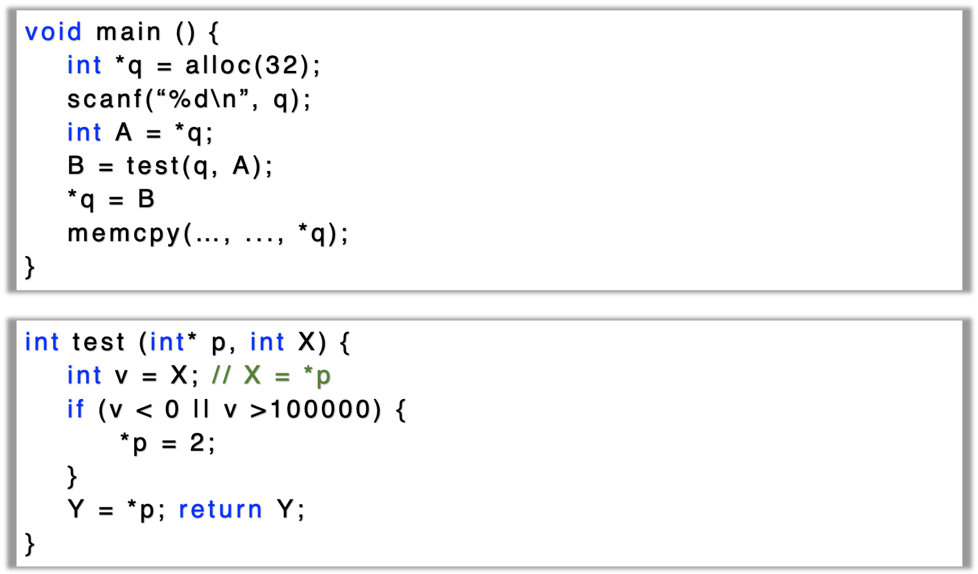
sink
memcpy(…, *q)
q
source
A
B
no need
to build!
75% ~ 95%
Y
p
v
2
X
*p = 2
Notes:
When tracking value flows, the local DDG can be stitched together only when necessary, by connecting their interfaces.
For example, when tracking value flows from the user input A, we connect the forma/actual parameters.
So we know the value of A flows to the variable X, then flows to v and Y. We then connect the return value and its recievers. and finally reaches the memcpy function.
Note that, we do not create inter-procedural DD, from q to p, that are not related to the bug we are checking. so we can save a lot of computational resources. Based on our evaluation, compared to using an independent pointer analysis, we can reduce 75% to 95% efforts of computing inter-procedural pointer relations,.

Slide 38

Evaluation
Relatively Fast
1.5 hours for MySQL, a 2 MLoC project, full path-sensitivity and 6-levels of calls
High Recall
Detected >100 serious bugs in ~30 extensively checked open source projects.
Some bugs have been hidden for >10 years
Build on LLVM
Checking Bugs in C/C++ Programs
Good Precision
15% ~ 30% false positives
Notes:
We implemented our approach as the tool Pinpoint on top of LLVM to check bugs in C/CPP programs.
The performance of pinpoint is aligned with the common industrial requirement.
It is relatively fast as it can check MYSQL, a 2MLOC project in 1.5 hours, with the precision of full path-sensitivity and 6-level function calls.
It has a high recall. We have detected more than 100 bugs in 30 extensively checked opensource projects. Some of the detected bugs have been in the code for more than 10 years.
Pinpoint is also very precise, as it produces less than 30% false positives.
19m30

Slide 39


Benchmarks
mcf
bzip2
gzip
parser
vpr
crafty
twolf
eon
gap
vortex
perlbmk
gcc
webassembly
darknet
html5-parser
tmux
libssh
goaccess
shadowsocks
swoole
libuv
transmission
git
vim
wrk
libicu
php
ffmpeg
mysql
firefox
Notes:
The benchmarks we choose to evaluate pinpoint include 12 SPEC benchmark programs and 18 github trending projects.

Slide 40
Benchmarks
3
> 1,000KLoC
6
< 1,000KLoC
Project | LoC
firefox | 8M
mysql | 2M
ffmpeg | 1M
21
< 100KLoC
Notes:
The sizes of these programs range from a few thousand LoC to close to 8million
The three largest programs are firefox, a commonly used browser; mysql, the most popular open-source relational DB, and ffmpeg, an audio and video processing software.

Slide 41
Evaluation Setup
Compare to both academic and industrial tools for checking use-after-free/double-free
High bar to quantify bug finding capabilities
Count as a true bug only if a report is confirmed by the developers.
Academic Tool by Sui et al.
Powered by LLVM
Powered by Facebook
Notes:
In the evaluation, we compare pinpoint with tools from both academia and industry for checking use-after-free and double-free bugs.
SVF is an academic tool for sparse value flow analysis. Clang and Infer are two bug detectors powered by the LLVM community and the Facebook Incorporation.
We want to highlight that we set a high bar for true positives in the evaluation. That is, A bug report is counted as a true bug only if it s confirmed by the software develoeprs.

Slide 42
MySQL #87203: Use After Free in MySQL
1
Refuse to confirm
You can do the free operations three times in a row.
One of the four use after free in MySQL
A bug in an 1,000 LoC function
36 functions/11 compilation units
2
Difficult to confirm
We do a lot of analysis. … This remains “Not a Bug”.
3
Confirm
This bug is verified by dynamic methods (debugger).
Notes:
Pinpoint can detect very complex bugs. As an example, this is one of the 4 UAFs we detect in mysql, which occurs in a 1KLoC Function.
When we just report it to the developers, they cannot believe and tell us, they have done some magic operations and we can use a pointer after free without any risks.
After some discussion, they start to do some analysis and still cannot confirm the bug.
Finally, with the help of some expensive debugging tools, they then confirm the complex bug

Slide 43





ICU #13301: Double Free in ICU
It had been in the code for more than
10 years.
Affected hundreds of organizations.
Assigned CVE-2017-14952
Notes:
Pinpoint can detect bugs with high impacts.
This is a double free bug in ICU, which has been in the code for more than 10 years, although ICU is extensively checked by mature bug detection tools.
This bug affects hundreds of organizations and projects, and is assigned with a CVE ID due to the security impract.

Slide 44
Scalability
2 MLoC
1.5 Hours
8 MLoC
4 Hours
Memory
Time
Notes:
In terms of scalability, we observe that the time and memory cost of Pinpoint grows almost linearly in practice.
For mysql, a 2MLoC project, pinpoint takes 1.5 hours to finish.
For Firefox, a 8MLoC project, pinpoint takes about 4 hours to finish.
So, Pinpoint is very scalable

Slide 45
Precision
True Positives
False Positives
Pinpoint
# FP | 2
# TP | 12
Time | ~ 5 hr
SVF
# FP | > 1K
# TP | ~ 0
Time | > 12 hr
Clang
# FP | 24
# TP | 2
Time | < 1 hr
Infer
# FP | 35
# TP | 0
Time | < 1 hr
Notes:
In terms of precision, pinpoint detected 12 real UAFs with 2 false positives.
SVF reports thousands of false warnings due to the imprecision of pointer analysis. For some projects, it may take more than 12 hours to finish.
We also compare pinpoint with two open source bug detector, clang and infer. Both of them sacrifice precision and recall for speed.
They can finish checking each project in one hour, but have high false positives and false negatives. For example, Clang reports 24 false positives with only 2 real bugs. Infer reports 35 false positives without any true bugs.

Slide 46
All Problems Addressed?
The previous evaluation
A single bug type: double free/use-after-free
Up to eight million lines of code
The amount of computation could be much larger
How about checking many bug types together?
No!
Notes:
Although we have shown very promising results,
we have to say not all problems have been addressed.
In the previous evaluation, we only check a single bug type and the size of the benchmark programs is up to 8MLOC
In practice, the amount of computation could be much larger. For example how about checking many bug types at the same time?
23m10

Slide 47
Technical Contributions
The Target Software Bugs – Value-Flow Problems
Escaping from the Pointer Trap
Conquering the Extensional Scalability Problem
Breaking the Limit of Parallelism
Notes:
To solve this problem, we propose our second work, which aims to improve the scalability for checking multiple value flow problems at the same time.
23m30

Slide 48
The Versality of Value-Flow Problems
Memory safety
null dereference, double free, use after free, use of uninitialized variable…
Resource usage
memory leak, socket leak, …
Security properties
the use of tainted data, …
Fortify, a commercial static code analyzer
nearly ten thousand value-flow problems from hundreds of unique categories
Notes:
As discussed before, value flow problems are very common in practice, including
the memory safety problems, such as null dereference and double free
resource usage problems, such as memory leak and socket leak
and security problems. such as the use of tainted data
Fortify, a commercial static code analyzer checks nearly 10 thousand value flow problems from hundreds of uniq categories.
24min

Slide 49
The Extensional Scalability Problem
Static analyzer often needs to check many problems at the same time
It will be very time- and memory-consuming
More program states to explore, more computation redundancy
Pinpoint exhausts 256GB of memory for checking only eight value flow problems.
The analysis logic of different properties are relatively independent between each other
Redundant graph traversals and unnecessary invocations of the SMT solver
Notes:
So, in an industrial setting, static analyzers often need to check many problems at the same time, which will be very time and memory consuming because more program states need to explore and there will be more computation redundancy.
For instance, Pinpoint, our previous work, exhausts 256G memory for checking only 8 value flow problems.
The main problem is that the analysis logic of checking different problems are independently between each other, which leads to redundant graph traversals on the DDG and unnecessary invocations of the expensive SMT solver.

Slide 50
The 2nd Contribution: Inter-Property-Aware Analysis
Use the analysis results of a property to speed up the analysis of other properties
Inter-Property-Aware Analysis
Use the Mutual Synergy to
Reduce Unnecessary Graph Traversals and SMT Solving
Notes:
Our 2nd work is an inter-property-aware analysis, which uses the analysis results of checking one problem to speed up the analysis of other problems.
The basic idea is to utilize the mutual synergy among different value flow problems to reduce unnecessary graph traversals and SMT solving.

Slide 51
Mutual Synergy
and Path Contradiction
Path Overlapping
Memory-leak bugs
heap pointers → free statements
Free-global-pointer bugs
global pointers → free statements
the vertex c cannot reach any free statement
Notes:
We observe that the mutual synergy among different value flow problems are mainly in the forms of path overlapping and path contradiction.
For path overlapping, let us look at the example, where we aim to detect memory leak bugs and free global var bugs on the DDG on the right.
To detect ml, we need to search path from a heap pointer to free statements. To detect fgv bugs, we need to search path from a global variable to free statements.
Assume that we first check the memory leak bug by searching paths from the heap pointer a. during the graph traversal, we record the information that the vertex c cannot reach any free statements.
we use this information to speed up the analysis of the fgv bugs
when checking the fgv bug from the vertex b, we can directly stop at the vertex c, because we know that c cannot reach any free statement.

Slide 52
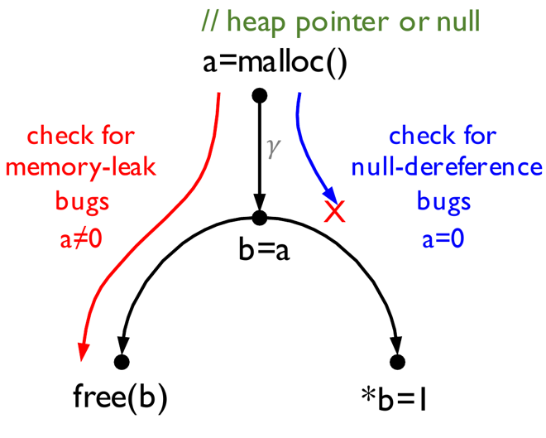
Mutual Synergy
and Path Contradiction
Path Overlapping
Memory-leak bugs
heap pointers → free statements
heap pointer condition: a ≠ 0
Null-dereference bugs
null pointers → dereference statements
null pointer condition: a = 0
𝛾 satisfiable but 𝛾∧a=0 not
=>
𝛾∧a≠0 is satisfiable
Notes:
This is an example of path contradiction, where we attempt to check ML bugs and NPD bugs. For both bugs, we need to search path from the vertex a, because a is the return value of function malloc. The function may return a heap pointer when it succeeds allocating a memory space or a null pointer when it fails.
We use the condition a!=0 to represent the heap pointer, and a=0 to represent the null pointer.
During the path traversal, we need to check whether the path condition conflicts with these bug-specific conditions.
For instance, when traverse the graph for checking the ND bug, at the vertex b, we will use a SMT solver to check whether the path condition gammar conflicts with the null condition;
Assume that the path condition gammar is SAT, but conflicts with the null pointer condition.
According to this information,
when checking ML by searching paths from the vertex a, we can directly determine the path condition gammar does not conflict with the heap pointer condition without invoking the expensive SMT solver.

Slide 53
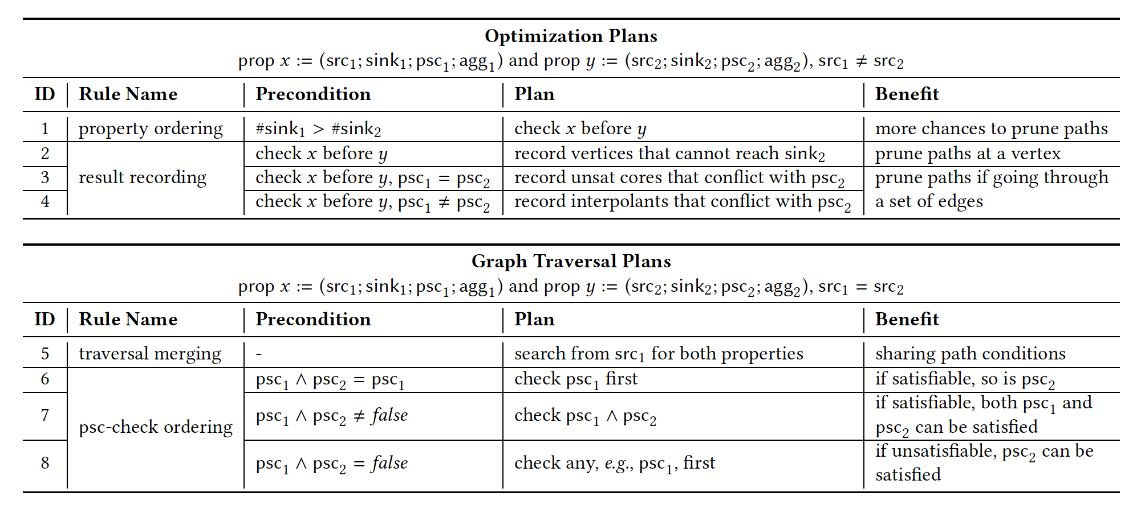
Notes:
In the thesis, we propose 8 optimization rules to sufficiently utilize the mutual synergy among different value flow problems, so that the static bug detector can efficiently check them together.
Due to time limit, I will not detail them one by one.

Slide 54
Workflow
share paths and prune paths
Source Vertices
Sink Vertices
Bug-Specific Conditions
Notes:
This is the work flow of our approach, the input is the specification of value flow problems to check.
Each specification mainly consists of three parts: the source vertices and the sink vertices that determine what kind of value flow paths we need to search on the data dependence graph, as well as the specific conditions each bug type needs to satisfy.
With the specifications, we make optimization plans so that the subsequent graph traversal engine can utilize the mutual synergy for sharing or pruning paths for detecting different value flow problems.

Slide 55

Evaluation
Benchmark – The same as in the evaluation of Pinpoint
Comparing with Pinpoint by checking 20 value-flow problems
Time Cost
Memory Cost
Notes:
for evaluation, we use similar benchmark programs from Spec and Github as before. and we compare our new approach with pinpoint in terms of time and memory cost.

Slide 56
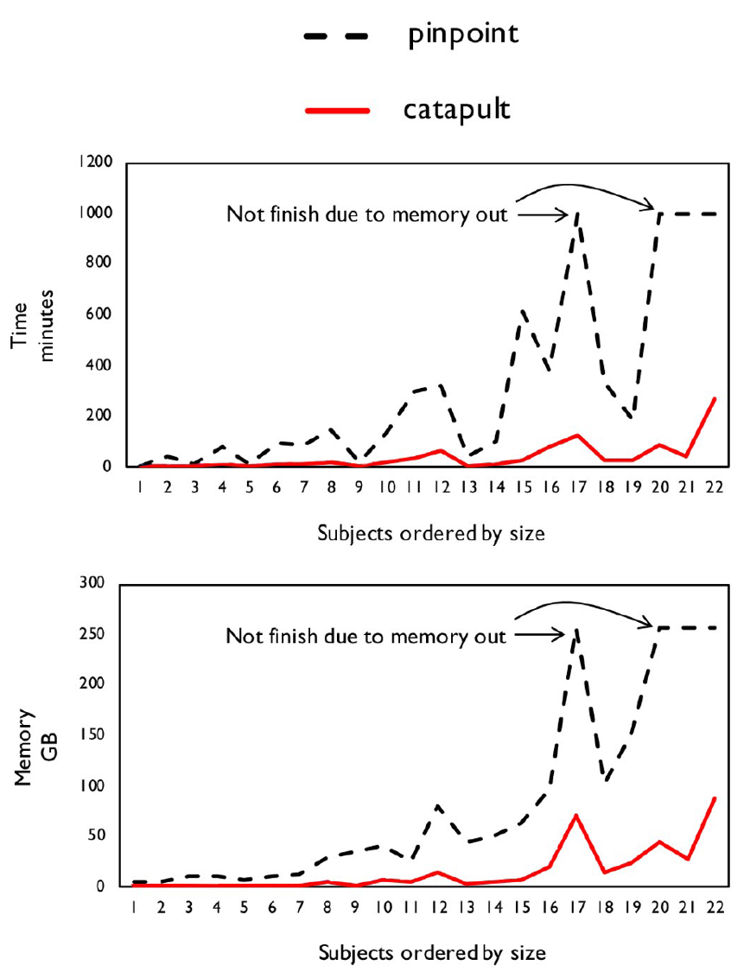
Efficiency: Time and Memory
Time reduction:
8X faster than Pinpoint
Memory reduction
1/7 memory of Pinpoint
Notes:
The figure on the left illustrate the results of comparing our new approach to Pinpoint. The x axis is the benchmark programs ordered by their sizes and the y axis is the time and memory cost. The black lines are the time and memory cost of pinpoint and the red lines are the cost of the new approach.
Compared to Pinpoint, the new approach is 8 times faster but only consumes 1/7 memory. Sometimes Pinpoint exhausts all 200GB of memory and raises an out-of-memory exception. In comparison, the new approach never exhausts the memory.

Slide 57
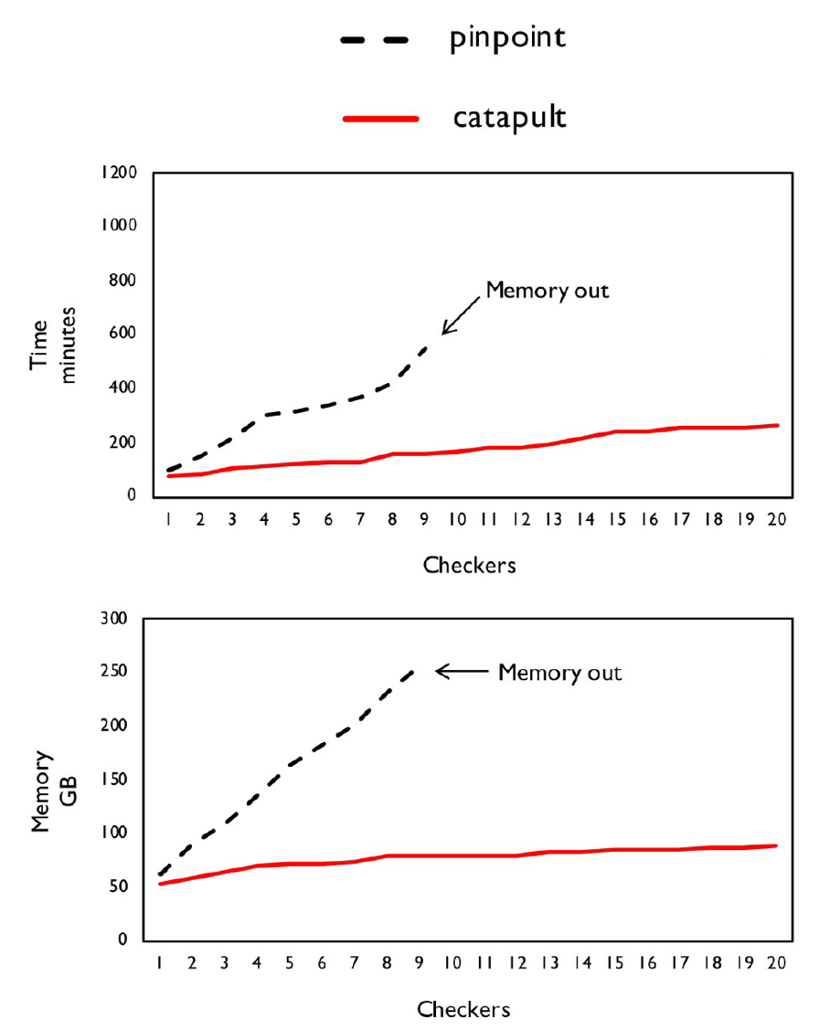
Efficiency: Time and Memory
Time reduction:
8X faster than Pinpoint
Memory reduction
1/7 memory of Pinpoint
Extensional Scalability
Add the value-flow problem one by one
Time and memory grow much slower
Notes:
We also draw the growing curves of the memory and time cost against the number of value flow problems to check.
We observe that the time and memory cost grow much slower than pinpoint, so, we believe the new approach is more scalable with regard to the number of value flow problems.
30

Slide 58
Technical Contributions
The Target Software Bugs – Value-Flow Problems
Escaping from the Pointer Trap
Conquering the Extensional Scalability Problem
Breaking the Limit of Parallelism
Notes:
Our third work is to improve the parallelism of the system over conventional parallel designs.

Slide 59

Bottom-up Analysis
Callees are analyzed before callers
Callees’ behaviors are recorded as function summaries
Callers use the summaries to analyze call sites
Easy to parallelize
Functions without calling dependence can be analyzed in parallel
Saturn
void f() {
…
int * a = g();
*a = 1; //safe?
int * b = h();
*b = 1; //safe?
}
Notes:
In practice, to run in parallel, conventional approaches are often implemented in a bottom up manner.
In a bottom up analysis, callees are analyzed before callers and the analysis results of a callee function are recorded as function summaries, which summarize the function hehavior.
For example, we have three functions where f calls g and h. So we firstly analyze g and h, generating function summaries by recording whether they will return invalid pointers. With these summaries, we then analyze the caller function f to check whether the invalid pointer may be improperly used.
Bottom up analysis is easy to parallelize. This is because functions without calling dep can be analyzed in parallel. so in the example, we can analyze g h at the same time and then analyze f.
31m30

Slide 60
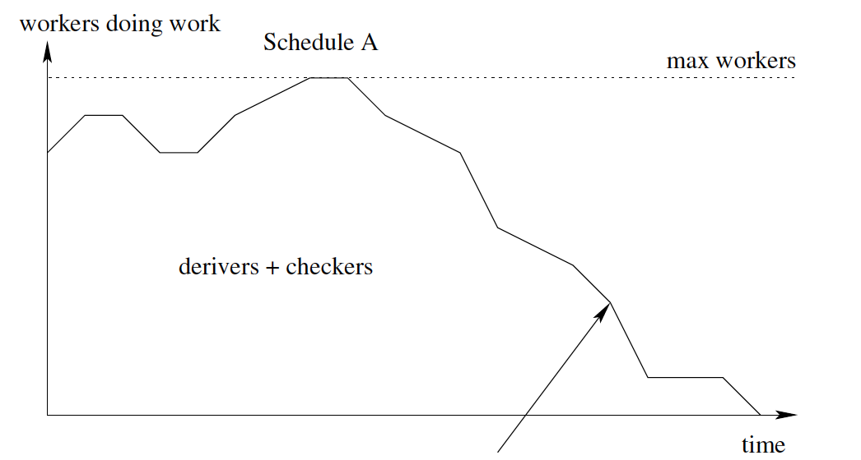
Parallelism is Limited
Any chance to increase the parallelism?
[Scott McPeak et al. FSE 2013]
Notes:
However, as pointed out by recent studies, the parallelism is limited.
As shown by the graph, the x-axis is the running time, and the y-axis is the CPU utilization rate. We can observe that the CPU utilization rate drops off at the second half of the analysis.
This is mainly because the call graph is usually a tree-like graph, the bottom-half of a call graph is usually very sparse and thus has sufficient parallelism. The top half of a call graph is usually very dense. Thus, the parallelism is limited by the calling dependence.
A nature question here is that is there any chance to improve the parallelism so that the analysis can finish earlier.

Slide 61
The 3rd Contribution: Improving the Parallelism
Intuition: It is not necessary to start the analysis of a function until we get all the analysis results of its callees.
Basic Idea: Relaxing the calling dependence
The problem to solve: the partition criteria.
Notes:
Intuitively, it is not necessary to start the analysis of a function until we get all the analysis results of its callees.
Thus, our basic idea is to relax the calling dependence between functions. Ideally, we can partition the analysis task into multiple parts, so that they can be pipelined as shown by the graph.
The remaining problem to solve is how to partition the analysis of a function

Slide 62
Function Summaries
Example: tracking value flow of null pointers
Function summaries to generate for foo:
Type I: value flow starting from a parameter, e.g., p
Type II: value flow starting from a nullptr in the current function, e.g., q
Type III: value flow starting from a nullptr returned by a callee, e.g., r
void foo (int* p) {
int* q = nullptr;
…
int* r = bar();
…
}
// nullptr may be from a caller
// nullptr may be from the current function
// nullptr may be from a callee
Notes:
Before introducing the partition method, let us look at what kind of function summaries we need to generate for a value flow analysis.
Here, we use the null pointer analysis as an example.
Given a function, null pointer may come from three places, from a caller function via the function parameter, from the current function, or from callees via the function return value.
According to where a null pointer may come from, we generate three types of function summaries:
Type 1 summary is the value flow from the function parameters
Type 2 summary is the value flow from the null pointer in the current function
type 3 summary is the value flow from a null pointer returned by callee functions.

Slide 63
Function Summaries
bool y = …;
int* foo() {
int* p = bar(null₁);
return p;
}
int* bar(int* a) {
int* b = null₂;
int* c = y ? a : b;
return c;
}
null₁
bar
a
null₂
(type-1) a⤳ret c
(type-2) null₂⤳ret c
b
foo
c
(type-2) null₁⤳a⤳ret c⤳p⤳ret p
(type-3) null₂⤳ret c⤳p⤳ret p
ret c
bar
time
p
ret p
foo
Notes:
Here is an example where function foo calls the function bar. The red part is the DDG of the function bar, and the black part is DDG of the function foo.
Following a conventional bottom-up analysis, we first analyze the callee function, and generate two summaries. the type-1 summary which is the value flow from the function parameter a to the return statement. the type 2 summary, which is the value flow from a null pointer to the return statement
Second, we analyze the function foo, using the function summaries, we generate a type 2 summary, and a type 3 summary. One is the value flow from the null pointer in the current function to ret p and the other is from the null pointer in the callee function to ret p

Slide 64
Partition Criteria
Given a pair of functions: foo calls bar
foo
Type I: Parameter → Return
foo
Type II: null in current func → Return
foo
Type III: null from callee → Return
bar
Type I: Parameter → Return
bar
Type II: null in current func → Return
bar
Type III: null from callee → Return
Notes:
In our approach, we partition the analysis task of a function into three parts, each part generates a type of function summaries.
Given a pair of functions where foo calls bar, a conventional approach conservatively assume that all the analysis tasks in the caller function depend on all analysis tasks of the callee function.
So, we need to finish all tasks in the callees and then start to analyze the callers.

Slide 65
Dependence Analysis
Given a pair of functions: foo calls bar
All the dependences are necessary? No!
foo
Type I: Parameter → Return
foo
Type II: null in current func → Return
foo
Type III: null from callee → Return
bar
Type I: Parameter → Return
bar
Type II: null in current func → Return
bar
Type III: null from callee → Return
Notes:
However, we observe that not all such deps are necessary, as the red dependence relations actually can be removed.
Thus, we have opportunities to improve the parallelism.
35min

Slide 66
Dependence Analysis
Given a pair of functions: foo calls bar
All the dependences are necessary? No!
foo
Type I: Parameter → Return
foo
Type II: null in current func → Return
foo
Type III: null from callee → Return
bar
Type I: Parameter → Return
bar
Type II: null in current func → Return
bar
Type III: null from callee → Return
Notes:
Let us look at the example.
We can observe that the type2 summary of foo depends on the summary of bar.
That is, the blue path in the figure goes through the yellow path from the function bar.
So the black dep is necessary.

Slide 67
Dependence Analysis
Given a pair of functions: foo calls bar
All the dependences are necessary? No!
foo
Type I: Parameter → Return
foo
Type II: null in current func → Return
foo
Type III: null from callee → Return
bar
Type I: Parameter → Return
bar
Type II: null in current func → Return
bar
Type III: null from callee → Return
Notes:
The blue path does not go through the type2 summary, the yellow path, of the function bar
so the red dep is not necessary and can be removed.

Slide 68
Pipeline Scheduling
Given a pair of functions: foo calls bar
foo
Type I
foo
Type II
foo
Type III
bar
Type I
bar
Type II
bar
Type III
Timeline
Notes:
After removing the red deps, we can schedule them in a pipeline manner
after generating the type 1 summary of bar, we can generate the type 1 and type2 summary of foo.
finally, we can generate the type 3 summary of foo after generating all summaries of bar

Slide 69
Function Summaries
bar
a⤳ret c
null₂⤳ret c
X
foo
bool y = …;
int* foo() {
int* p = bar(null₁);
return p;
}
int* bar(int* a) {
int* b = null₂;
int* c = y ? a : b;
return c;
}
null₁⤳a⤳ret c⤳p⤳ret p
null₂⤳ret c⤳p⤳ret p
time
a⤳ret c
null₂⤳ret c
√
null₁⤳a⤳ret c⤳p⤳ret p
null₂⤳ret c ⤳p⤳ret p
time
Notes:
Thus, for this example, our approach does not need to wait the analysis of bar to start the analysis of foo.

Slide 70
A Pipeline Parallel Strategy
We formalize the idea in IFDS/IDE framework for a wide range of problems
they can be reduced to a graph reachability problem
like our value flow analysis
Alias Sets
Problem
Secure
Information Flow
Type State
Analysis
Shape
Analysis
Specification
Inference
Notes:
In the thesis, we formalize the pipeline idea in the IFDS/IDE framework for a wide range of problems, such as the alias sets problem, the problem of securing information flow and so on.
These problems have a common feature that, they can be reduced to graph reachability problems, just like our value flow analysis.
36m30in

Slide 71
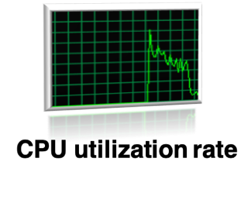
Evaluation
Benchmark – The same as in the evaluation of Pinpoint
Comparing with the conventional parallel design for bottom-up analysis.
Notes:
As for evaluation, we use similar benchmark programs as before
and compare the pipeline method to the conventional parallel design in terms of cpu utilization rate and the speedup.

Slide 72
CPU Utilization Rate
Notes:
These figures show the cpu utilization rate for analyzing some of our benchmark programs.
The red curves are the cpu utilization rate of our pipeline approach. The blue ones are that of the conventional approach.
It is clear that our approach has higher cpu utilization rate than the conventional one and thus can finish the analysis earlier.

Slide 73
Speedup
2×-3× faster is non-trivial
12 hours → 4 – 6 hours
impractical → practical
Notes:
This figure shows the speedup against the number of threads. Different lines represent the speedup of different benchmark programs
With more threads, the benefits of our approach is more apparent, leading to 2 times to 3 times speedup. Such a speedup is not trivial, in practice, it is enough to make an originally impractical analysis practical.
For instance, originally an analysis may need 12 hours, with our approach, it may only need 4 hours to finish. This means that originally, the analysis cannot finish in a nightly building, but it can finish after adopting our approach.

Slide 74
Factors Affecting the Results
Num of Threads
Sparsity of the Call Graph
More Threads, More Effective; More Dense, More Effective!
Notes:
For the pipeline approach, there are two factors that may affect its performance.
First, we have shown that with more threads , our approach is more effective. If we only have one thread available, neither of our approach and the conventional parallel design can perform parallel analysis. So they will have similar performance.
Second, the effectiveness of our approach is also affected by the sparsity of the call graph. Recall that our pipeline approach relax calling dependence to improve the parallelism. So if a call graph is very sparse and has little call dependence, then the benefits of our approach will not that apparent.

Slide 75
Conclusion
Scaling up the Sparse Value-Flow Analysis for Finding Bugs
in Industrial-Sized Code
Escape from the Pointer Trap
Avoid Independent Pointer Analysis
Conquer the Extensional Scalability Problem
Utilize the Mutual Synergy
Break the Limit of the Parallelism
Relax the Calling Dependence
Notes:
In the thesis, we make three major contributions to scale up the sparse value flow analysis for finding bugs in industrial sized code.
The first contribution is to escape from the pointer trap so that we can build precise DDG efficiently.
The 2nd one is to conquer the extensional scalability problem by utilizing the mutual synergy among different value flow problems, so that we can check them together efficiently.
The 3rd one is to break the limit of the parallelism by relaxing the calling dependence, so that we can better benefit from multi cores in modern computers.
39min30

Slide 76
Qingkai Shi, Xiao Xiao, Rongxin Wu, Jinguo Zhou, Gang Fan, Charles Zhang. Pinpoint: Fast and Precise Sparse Value Flow Analysis for Million Lines of Code. In PLDI 2018.
Qingkai Shi, Charles Zhang. Pipelining Bottom-up Data Flow Analysis. In ICSE 2020.
Qingkai Shi, Rongxin Wu, Gang Fan, Charles Zhang. Conquering the Extensional Scalability Problem for Value-Flow Analysis Frameworks. In ICSE 2020.
Gang Fan, Rongxin Wu, Qingkai Shi, Xiao Xiao, Jinguo Zhou, Charles Zhang. Smoke: Scalable Path-Sensitive Memory Leak Detection for Millions of Lines of Code. In ICSE 2019.
Gang Fan, Chengpeng Wang, Rongxin Wu, Xiao Xiao, Qingkai Shi, Charles Zhang. Escaping Dependency Hell: Finding Build Dependency Errors with the Unified Dependency Graph. In ISSTA 2020.
Peisen Yao, Qingkai Shi, Heqing Huang, Charles Zhang. Fast Bit-Vector Satisfiability. In ISSTA 2020.
Heqing Huang, Peisen Yao, Rongxin Wu, Qingkai Shi, Charles Zhang. Pangolin: Incremental Hybrid Fuzzing with Polyhedral Path Abstraction. In S&P 2020.
Notes:
Here is the the publications I contribute to during my Phd study. The first three are thesis-related publications.

Slide 77
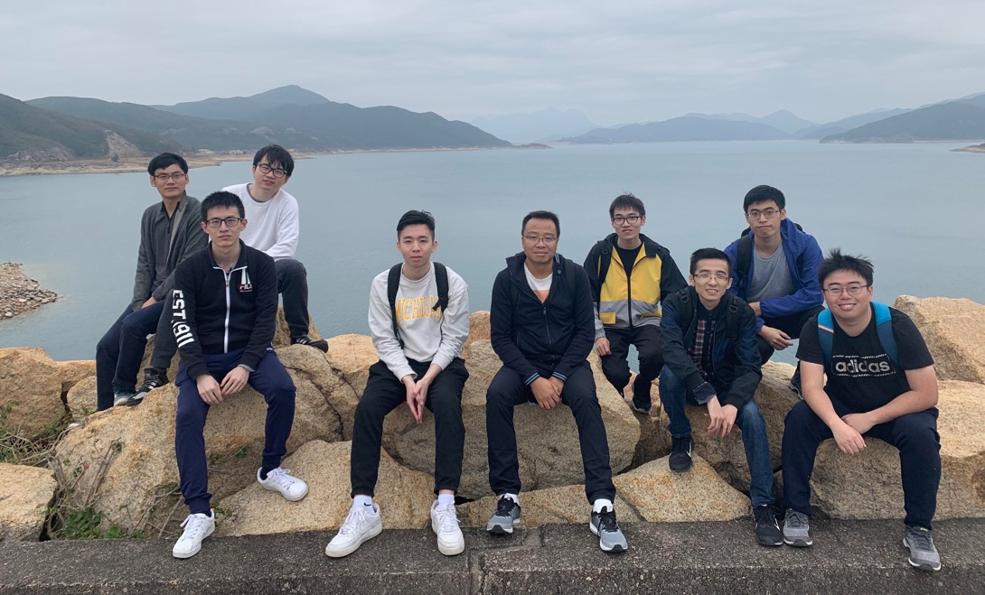
Acknowledgement
Supervisor: Prof. Charles Zhang
Chair: Prof. Qinglu Zeng
Committee Members:
Prof. Xiangyu Zhang (Purdue University), Prof. Weichuan Yu (ECE)
Prof. Shing-Chi Cheung, Prof. Shuai Wang
Notes:
Finally, I want to thank my advisor Prof Zhang, the chair person Prof Zeng, and all the committee members to attend my defense at this difficult time.
I also want thank all my friends for their help during my phd study. They may be not in the photo, but of course they are in my heart.

Slide 78
THANK YOU
Notes:
Thanks again for attending my defense. Thanks very much.
40min

Slide 79
Scalable and Precise Static Bug Finding for Industrial-Sized Code
PhD Thesis Defense
SHI, QINGKAI
Supervisor: Prof. Charles Zhang
Chair: Prof. Qinglu Zeng
Committee Members:
Prof. Xiangyu Zhang (Purdue University), Prof. Weichuan Yu (ECE)
Prof. Shing-Chi Cheung, Prof. Shuai Wang
Apr 23rd 2020

